Slide 1
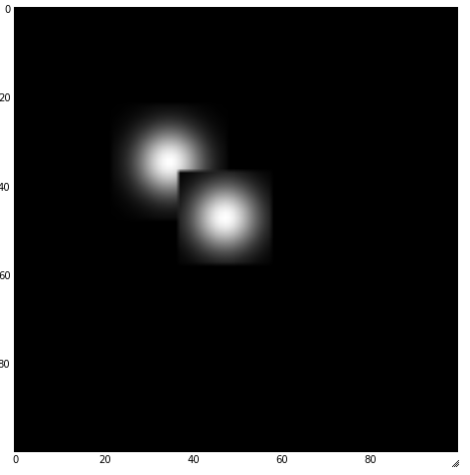
Overlapping Stamps

Slide 2
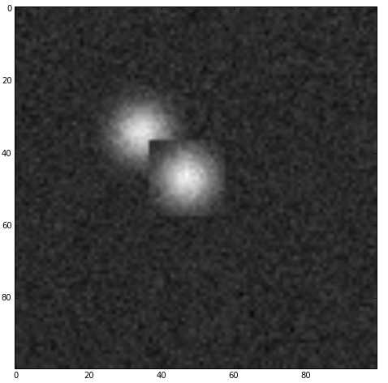
Overlapping stamps w/ background noise

Slide 3
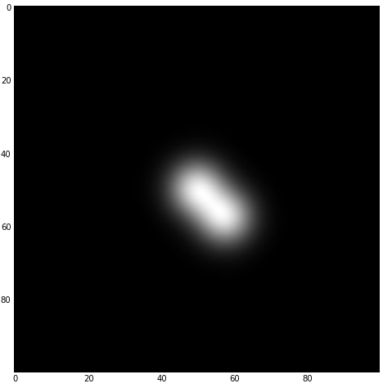
Overlapping Gaussian profiles

Slide 4
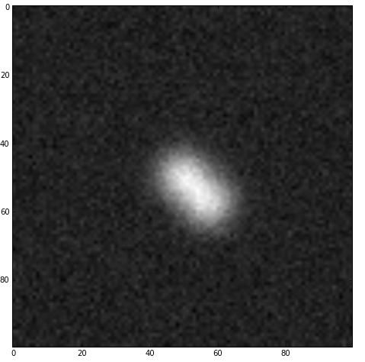
Overlapping Gaussians with noise

